Slide 1

Impacts of Victimization

Slide 2
https://www.instagram.com/reel/C8UVfAxAigv/?igsh=MWliN2FtMHdiMjZlOA%3D%3D

Slide 3
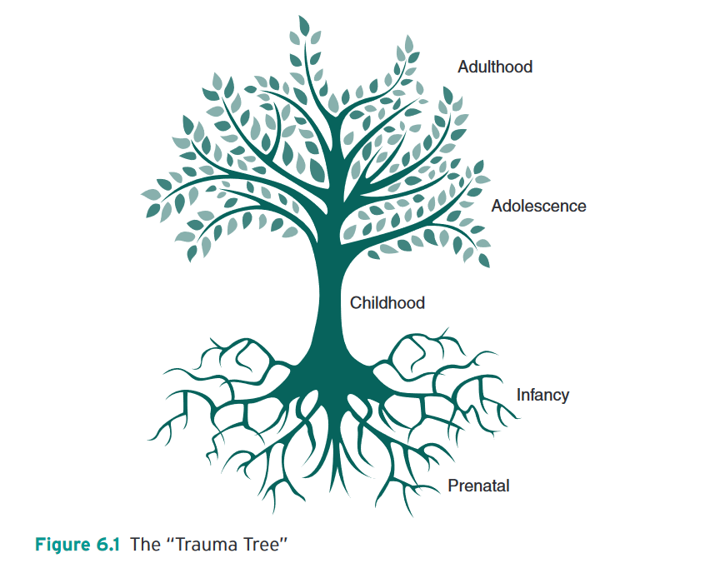
Turanovic and Pratt:

Slide 4
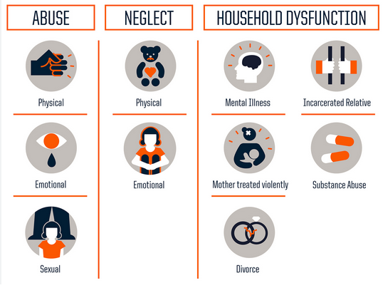
ACE (Adverse Childhood experiences)
“Adverse childhood experiences (ACEs) can have a tremendous impact on future violence victimization and perpetration, and lifelong health and opportunity.” – CDC 2024
Examples: experiencing violence, abuse, or neglect; witnessing violence in the home or community; having a family member attempt or die by suicide

Slide 5
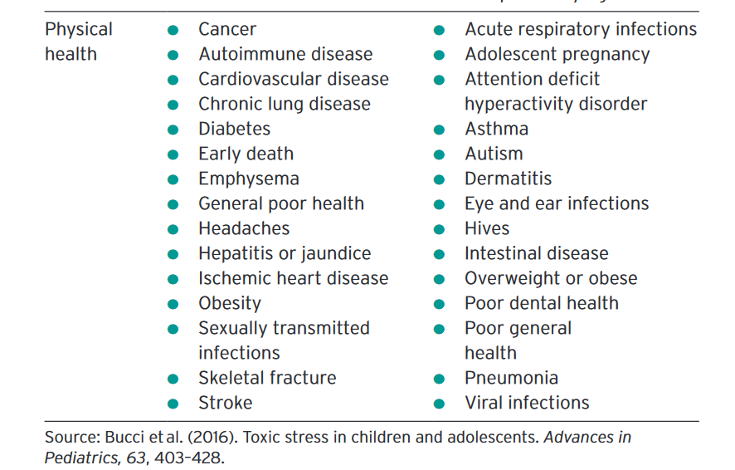
Lifelong impacts of child abuse

Slide 6
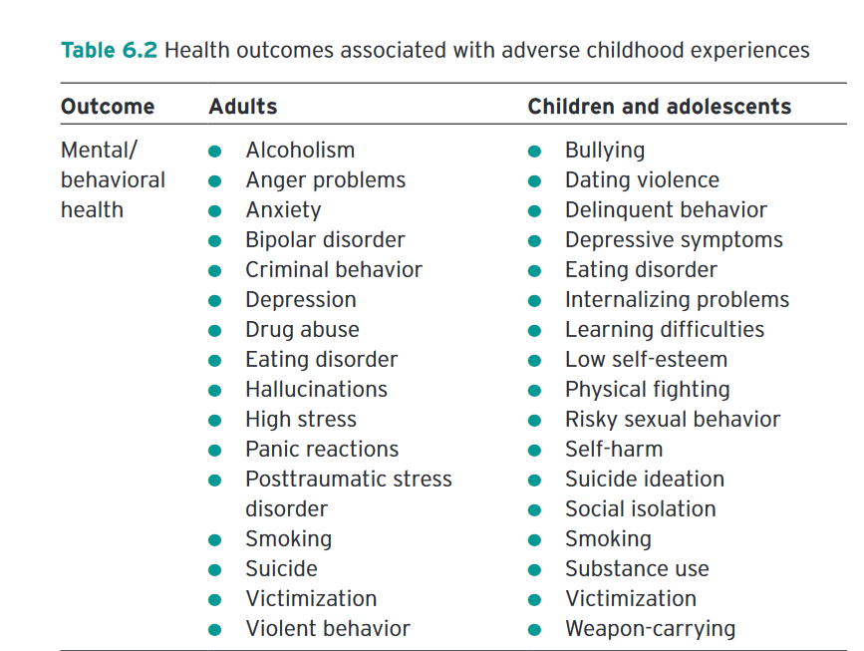

Slide 7
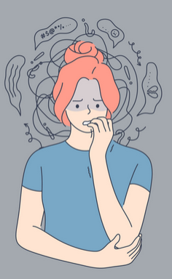
Trauma responses to victimization
PTSD
Anxiety
Depression
Substance abuse and related addiction disorders
Self-harming behaviours
(among others)

Slide 8
Why does victimization elicit a trauma response for some people, but not all? (Turanovic & Pratt)
Part of the reason why this happens has to do with how victims cope with their experiences. Victimization elicits strong negative emotions (e.g., anxiety, depression, anger, and frustration)
Victims feel pressured to alleviate these feelings through some form of coping.
“Coping” is defined as the process by which people regulate their behaviors and emotions under conditions of psychological distress (Agnew, 2006).

Slide 9

Coping takes two forms
Positive healthy coping:
therapy, taking care of one’s self, exercise, community engagement
Maladaptive or unhealthy coping:
substance use and abuse, venting negative emotion, self-harming behaviors, behavioral disengagement, and workplace deviance

Slide 10
Additionally,
Coping techniques may be cognitive or behavioral, and they seek to reduce or minimize the various demands of a stressful situation.
Here’s one of mine: “when feeling stressed over having to do something, I ask myself ‘do I need to do this right now?’ If the answer is no, then I make a plan to put it to a day/time when I can do the task more easily. ⬅ not same as procratinating

Slide 11

Threat Appraisal and Coping Theory (Lazarus & Folkman 1984)
This theory suggests that individuals experiencing stress engage in a cognitive appraisal of their current situation, and then evaluate their own ability to respond to their situation before deciding how to react.

Slide 12
Cont’d
The appraisal of the distressing situation strongly predicts the subsequent type of coping strategy employed. Thus, the assessment of the situation largely determines whether the individual will use positive, problem-focused coping (coping aimed at directly managing what is causing distress)
Or negative emotion-focused coping (coping aimed at regulating the associated emotions).
We used this to understand why some people ‘go missing’ (Huey and Ferguson 2023).

Slide 13
Social stress framework
Does everyone evaluate a situation similarly? Nope.
An additional factor we have to consider is that some people are additionally disadvantaged by their circumstances.
E.g. If I am victimized, I have health insurance that provides the ability to go to a therapist. If I was a minimum wage worker without benefits, going to a therapist would not be possible. I would have to find other ways to try to cope.
This is where Tyler et al.’s social stress framework comes in …

Slide 14

As Tyler and colleagues note …
Additional stressors can include:
Being without employment
Being unhoused
Living with economic or other insecurity
Being in constant fear of an abusive partner or family member
Lack of family or other emotional supports
Living with a stigmatized or marginalized social status

Slide 15
Social stress framework and self-injuring (Huey et al. 2014)
What is self-injuring?
a cluster of behaviours that include cutting, scratching, carving and burning of skin to interfering with wound healing, and includes inserting pins or other objects under the skin, biting one’s self, intentionally damaging bones, banging one’s head against hard surfaces and amputation or removal of body parts, among others (Favazza, 2012).

Slide 16
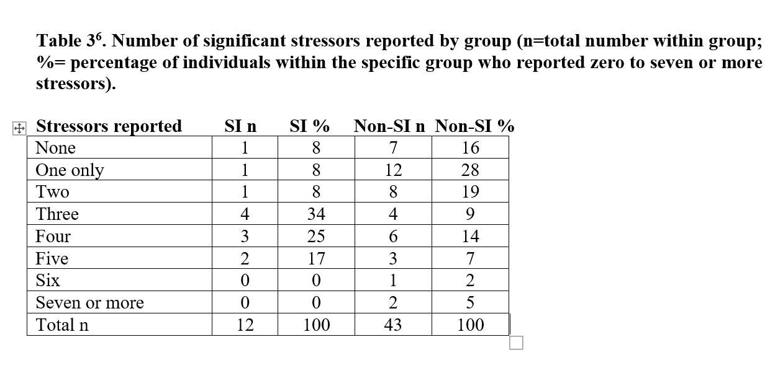
Social stress framework and self-injuring (Huey et al. 2014)
Of 55 homeless women in two UK cities, 12 self-identified as self-injurers, we found they were more likely to be dealing with 3 or more significant stressors.
What were these
stressors? ….

Slide 17
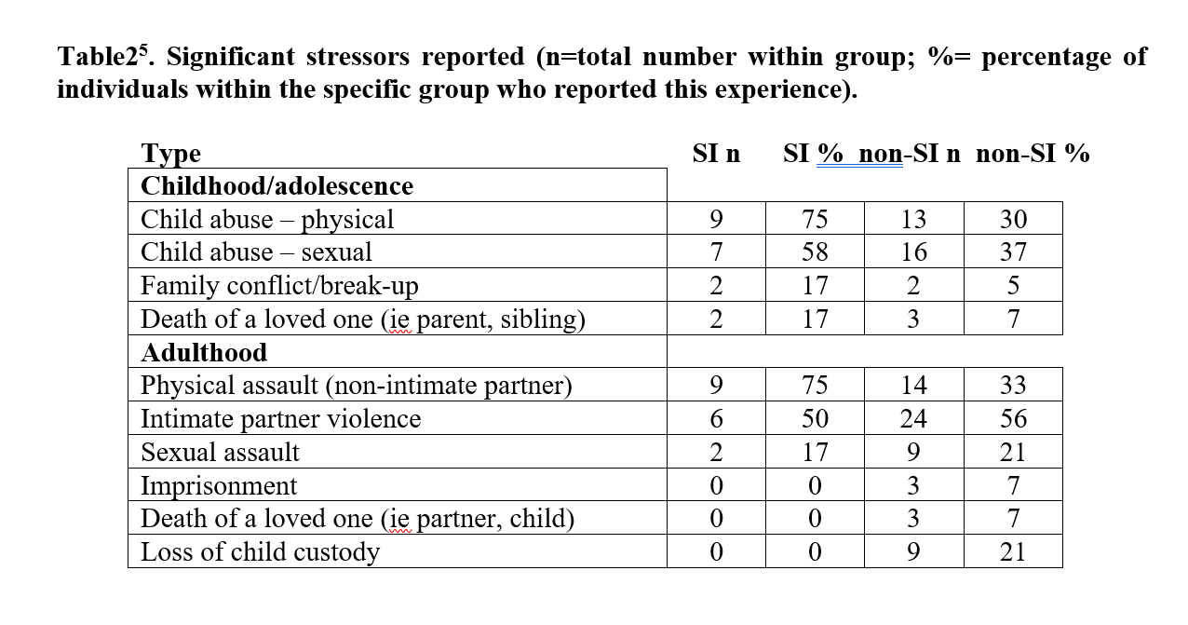

Slide 18
One young woman from Afghanistan said of herself, “I used to take beatings from my mom and my family.”
She saw her self-harming as an act aimed at hurting not herself, but her mother who had beat her:
“I had a lot of anger and that’s what kind of led me to cutting myself. It was my mom. I have a lot of anger in me and I can’t let it out on her, so I used to hurt myself, thinking that it would affect her.”
Her self-injuring behaviours began with feelings of agitation that lead to periods where she would “just start itching myself”. Intense scratching then progressed to cutting, as she sought greater relief from anxiety and anger.

Slide 19
In another related study, we also found …
Drawing on data collected from 269 structured interviews conducted with women using the services of homeless shelters and/or transitional housing in the U.S. and U.K., we discovered that adult victims of stranger-perpetrated physical assault are significantly more likely to be homeless on multiple occasions.
In addition, those who experience multiple forms of victimization (e.g., physical and sexual abuse) in childhood, adulthood, and/or across the life course are significantly more likely to experience multiple episodes of homelessness.

Slide 20
And, in line with the social stress framework
It is worth noting that women in the U.S. sample were disproportionately more likely to be Black and have been multiply victimized in child and adulthood.

Slide 21
I also want to note that …
Not only is there variability in terms of how people will process trauma – based on their life experiences, access to resources and social status – but also that not all forms of victimization run equal risk of causing harm.
“A recent meta-analysis of prospective studies investigating the prevalence of PTSD in sexual assault survivors reported a prevalence rate of 74.6% for PTSD 1-month post-assault and a prevalence of 41.5% at 12-months post-assault” (CDC 2023).

Slide 22

*all done!*

